Slide 1



Test Automation using UiPath Test Suite – Developer Series
Part 1 of 4

Slide 2


Meet today’s team:
Diana Gray
Community Marketing Manager AMER
@UiPath
Atul Trikha
Account Chief Technologist, RPA Architect, RPA CoE Lead
@Peraton
UiPath MVP 2022
UiPath Columbus Chapter Lead

Slide 3
About today’s UiPath developer meeting:
AMER Developer Community sessions
Managed by UiPath MVPs in Canada, Latin America & USA
You are encouraged to network with MVPs and share your LinkedIn in the chat box. We want to get to know you
These sessions are for you to engage with us on topics that interest you or that you want to share with the UiPath Developer Community
Please use the chat to place questions until Q&A
If you have any topics that you want us to cover, please email diana.gray@uipath.com

Slide 4



Date/Time | Topic | Status
July 12, 5PM EDT | Test Automation using UiPath Test Suite - Developer Series - Part 1 of 4 | Happening
July 19, 5PM EDT | Test Automation using UiPath Test Suite - Developer Series - Part 2 of 4 | Register Now
July 26, 5PM EDT | Test Automation using UiPath Test Suite - Developer Series - Part 3 of 4 | Register now
Aug 2, 5PM EDT | Test Automation using UiPath Test Suite - Developer Series - Part 4 of 4 | Register now
Register for Events at community.uipath.com

Slide 5






Vibrant ecosystem of more than 1,5 million professionals and citizen developers learning, getting support, and succeeding together in their automation careers.
Automation Cloud
Start with the free Community Edition to get trained and certified
Then upgrade to the Enterprise version of the product
Academy
Learn the skills of the future on UiPath Academy or through our Academic Alliance
Earn globally recognized credentials with UiPath Certifications
Forum
Get crowdsourced support and share product feedback on UiPath Forum
Check the product documentation
Join the Insider Preview for early testing
Community Events
Connect with like-minded people and share best practices with the UiPath Community
Solve challenges in engaging hackathon competitions
Join meetups and conferences
Blog and Tutorials
Access the latest articles and video tutorial content created by community members and UiPath engineers in our Community Blog
Contribute as an author.
UiPath Community MVPs
Get recognized as a Most Valuable Professional (MVP), Automation Champion or one of the Forum Leaders, based on the contribution to others’ growth
Join the UiPath Community

Slide 6
Thank You
For your participation
Join us: community.uipath.com

Slide 7

Test Automation using UiPath Test Suite 4 Parts Developer Series
Part 1: Building Blocks, Test Suite Product Overview
Part 2: UiPath Test Suite Family of Products
Part 3: Deep Dive into Test Suite capabilities
Part 4: Open Discussion and Wrap up
Notes:
This event is one in a line of events that we will be creating for developers and we would love to hear from you what you are interested in for future series.

Slide 8
Part 1: Building Blocks, Test Suite Product Overview
Revolutionize automated testing for your software, automation, and QA teams with Test Suite.
What is Software Testing,
Why Software Testing is Required
Typical Test Types and Levels
Continuous Testing and Challenges
Introduction to UiPath Test Suite
Test Suite and UiPath Automation Platform

Slide 9
Software Testing

Slide 10
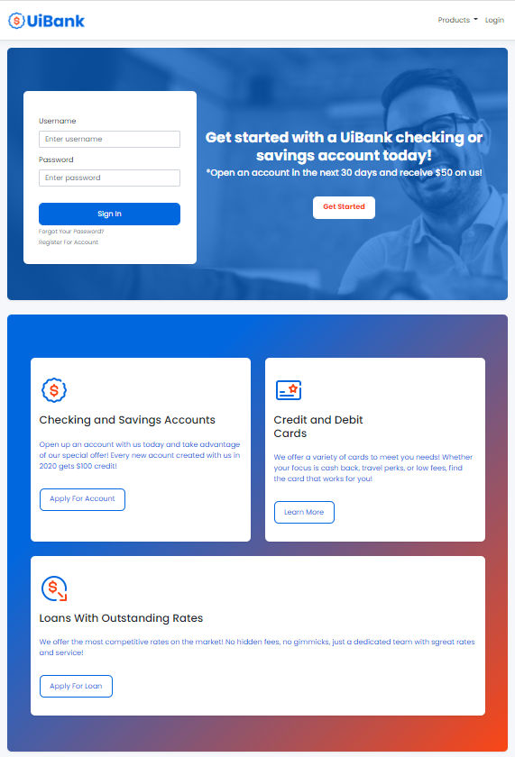
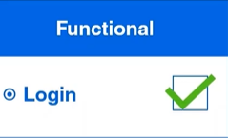
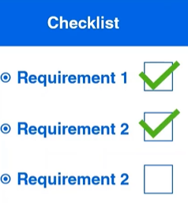
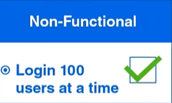
What is Software Testing?
Software testing is the process of verifying that a software meets certain requirements and
behaves as expected.
Notes:
Software testing is the process of verifying that software meets certain requirements and behaves as expected.
When we talk about testing requirements, we need to differentiate between functional and non-functional.
- A functional requirement generally refers to expected behavior. e.g., Login Functionality
- A non-functional requirement does not focus on a specific behavior. It rather evaluates the operation of a system.

Slide 11
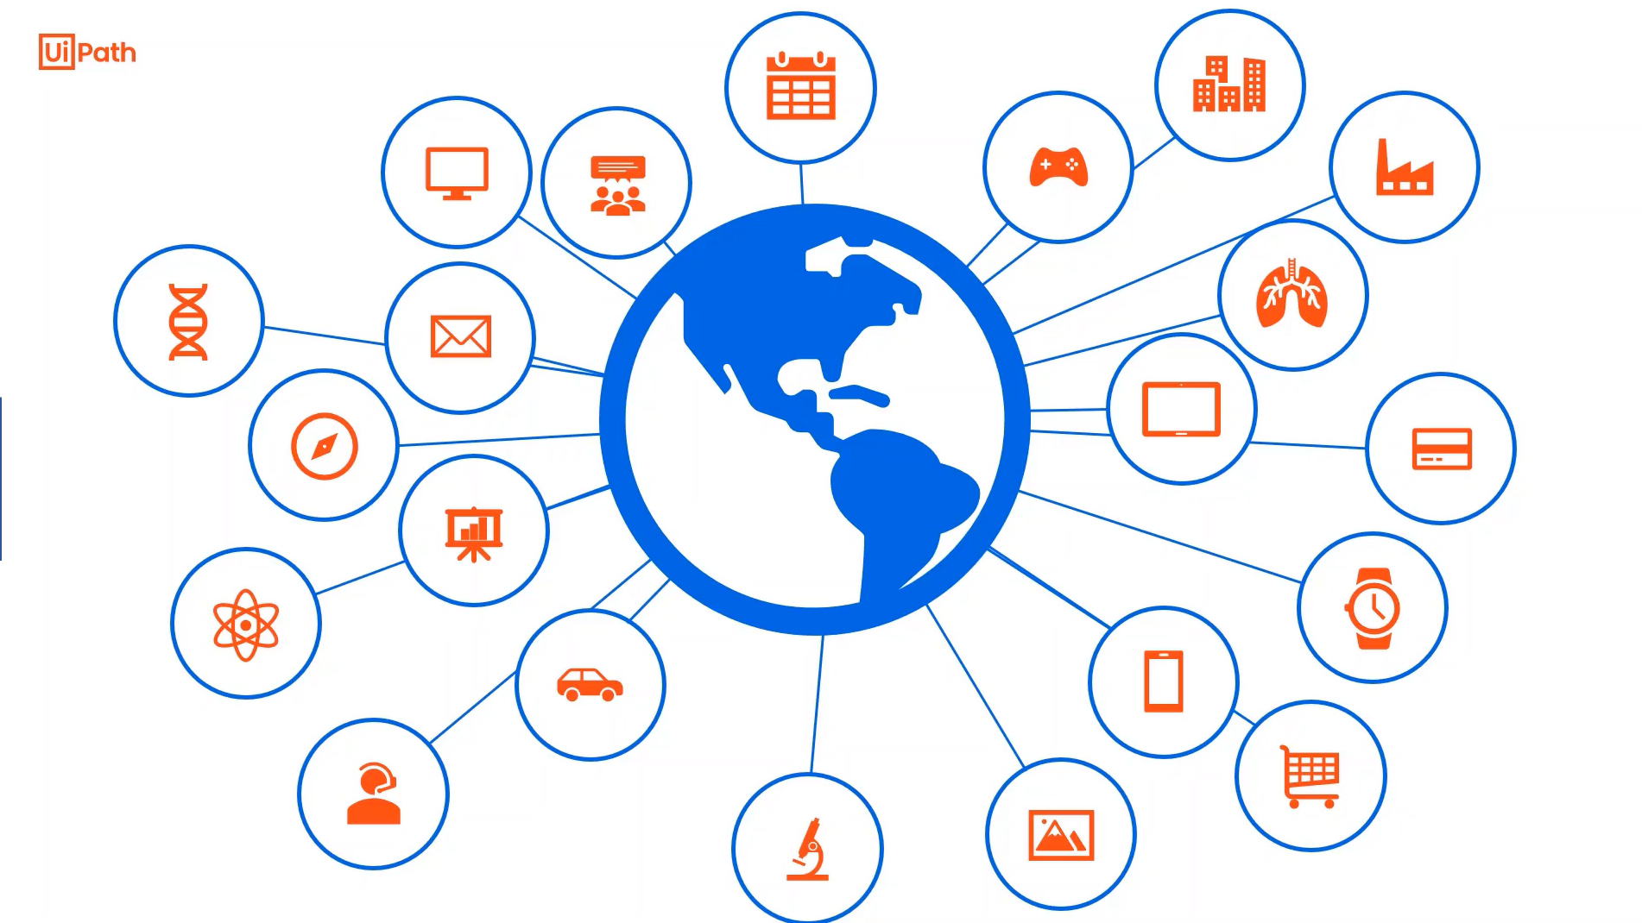
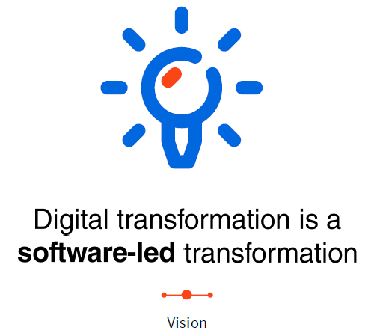
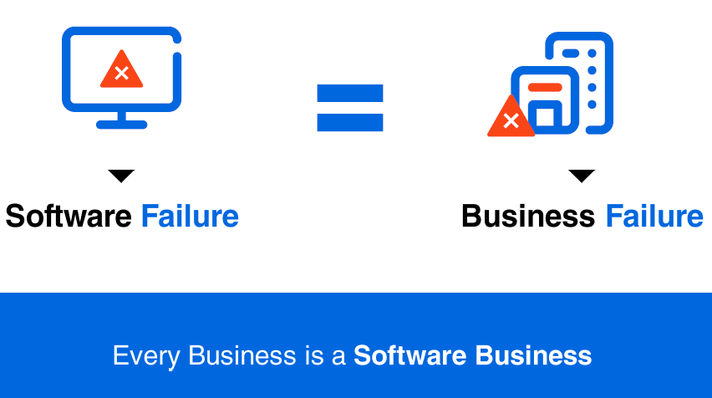
Why Software Testing is necessary?
Software systems are now integral part of our daily lives.
Notes:
Software systems are now an integral part of our daily lives. They help us cover many of our needs and even solve some of the challenges we are facing. We are using apps for Home banking, Order food, shopping, transportation, paying bills, and meetings. The rise of digital technologies and emerging business models have fundamentally changed the way interact with software products. This phenomenon is called digital disruption. Think about Uber, a driving service without any car. Airbnb is an accommodation service without any properties. Their business model is their sole asset: the software.
This evolution has made its way into every industry. The software has become the number one technology in any kind of business. "Every Business is a Software Business". Software failure becomes Business Failure.
That is why Software testing is of paramount importance.

Slide 12
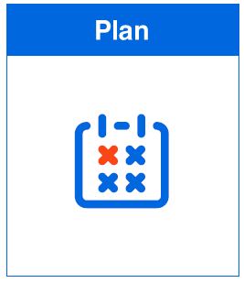
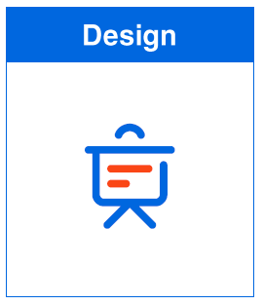
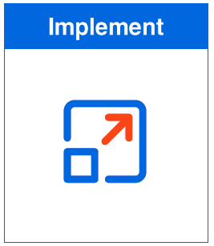
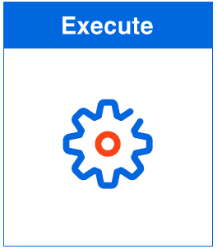
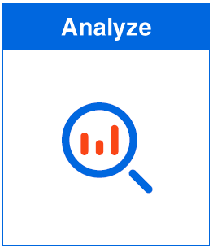
What does a traditional test process look like?
Plan Phase:
It all starts with SME or Product Owner setting the testing objectives in the plan phase
The objectives are often derived from functional or non-functional requirements
The Testing approach, testing schedule and the success criteria are also addressed in this stage
Design Phase:
Transform the objectives into a list of high-level, periodized test cases
Prepare Test data and identify test environment
Analyze Phase:
The last stage should close the loop. Remember the goal of testing to provide data on the quality of software and identity risk related to software release.
Thorough analysis and different layers of reporting will offer the means to the stakeholders to make informed decision about the release go live or postpone.
Execute Phase:
Run test sets according to the test plan
We can follow a defined schedule or test continuously with every code change
We can trigger testing manually or automatically.
Implementation Phase:
Create all the assets needed for execution, Manual or Automated Test Cases
Group test cases in test sets
Build the test environment
Notes:
Plan Phase:
It all starts with SME or Product Owner setting the testing objectives in the planning phase.
The objectives are often derived from functional or non-functional requirements.
The Testing approach, testing schedule, and success criteria are also addressed in this stage.
Design Phase:
Transform the objectives into a list of high-level, periodized test cases.
Prepare Test data and identify the test environment
Implementation Phase:
Create all the assets needed for execution, Manual or Automated Test Cases.
Group test cases in test sets
Build the test environment
Execute Phase:
Run test sets according to the test plan.
We can follow a defined schedule or test continuously with every code change.
We can trigger testing manually or automatically.
Analyze Phase:
The last stage should close the loop. Remember the goal of testing to provide data on the quality of software and identity risk related to software release.
Thorough analysis and different layers of reporting will offer the means to the stakeholders to make informed decision about the release go live or postpone.

Slide 13
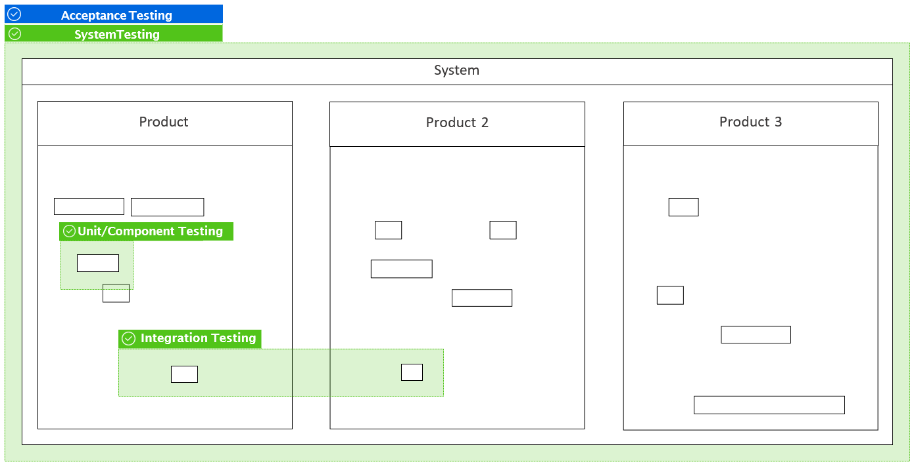
What are typical test levels?
Notes:
Unit/Component Testing: Focus on testing individual ‘code’ units, down to the level of methods and functions. Done by Software Developer. And we typically mock objects and environments.
Integration Testing: Focus on the interactions between the components or systems. We verify if the interfaces between components are designed as specified.
System Testing: Focus on the behavior of an entire software system or product. It is also referred to as End-to-End testing. Pre-Production Environment
Acceptance Testing: It also deals with the entire software system or product. We don’t include dev or tester, instead, we include end-users or other key stakeholders.

Slide 14
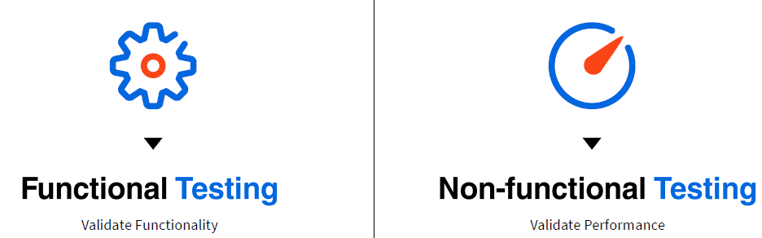
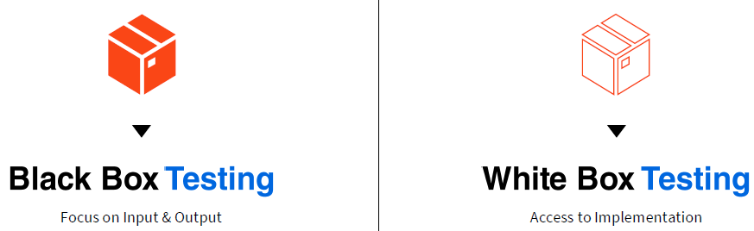
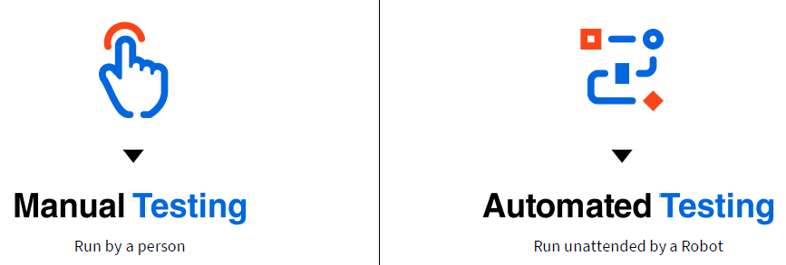
What are the typical test types?
Notes:
Functional vs Non-functional: we have introduced a bit earlier.
Black Box vs White Box Testing: The main difference between the two is the visibility and access of the tester to the actual implementation.
-Black Box testing solely focuses on providing a certain input and verifying the output (conducted by the tester, System, and Acceptance Testing).
-White Box testing provides a certain amount of access to the source code to the tester (conducted by the developers, unit, and integration testing).
At a first glance, Manual Testing is run by a person, Automated Testing is run by an unattended robot.
At a closer look, we will discover that there’s a complex layer for each of them.

Slide 15
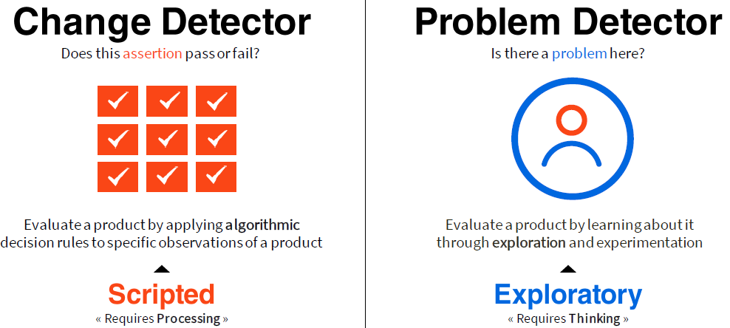
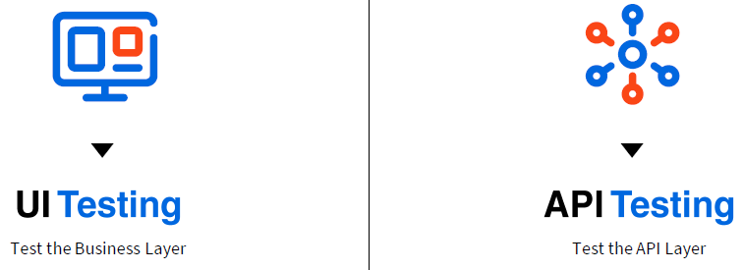
Manual Testing
Automated Testing
Notes:
Scripted Manual Test we have pre-defined steps of operations, followed by a specific verification steps. This type of testing is intended to be executed the same way every time it is performed. Scripted manual test are repetitive actions. So, just like any other repetitive task, they should be automated whenever it is technically possible and feasible in terms of efforts.
Exploratory testing is still manually performed, but it typically provides a high-level charter. Then it leaves to the actual tester to explore in detail.
Automated Testing is also typically of two types, matching the 2 main layers within a typical software application: UI and the API.

Slide 16
Millions of manual processes result in lost productivity and lower job satisfaction
Financial close and reporting
Patient registration
Vendor management
Performance management
Account reconciliation
Contract management
Security validation
Self-service automation
Chatbot integration
HR Recruiting
Customer on-boarding
Product information management
Test Data Management
Regression Testing
Campaign management
Health tracking
Unit Testing
Clinical trial and patient management
Customer communications
Order management
Customer service
Loan processing
Know Your Customer
Vendor management
Master data management
E-discovery
RPA Testing
50%+ decline in productivity growth
Data migration
Billions
of hours spent daily on manual tasks
~70%
Increase in apps / company over last 4 years
Invoice Processing
Accounts receivable
Data processing
Network management
Legal research
Cybersecurity
Billing
(1)
(2)
(3)
Sales analytics
Trade execution
Accounts payable
Credit Checks
Mass communications
CRM updates
Compliance reporting
Track and trace
GDPR Compliance
Risk monitoring
Asset management
Employee set-up
Procurement
Employee on-boarding
Supply Chain execution
Help desk requests
Expense management
Customer data integration
Software Deployments
Supplier validation
Lead management
Data cleansing
Tax Reporting
Claims Management
ERP exception processing
Customer management
Deal analysis and execution
Fraud detection
Refund processing
Payroll processing
Environment Management
Supplier validation
HR administration
Acceptance Testing
FX and VAT reporting
Payroll automation
Test Case Design
Field dispatch services
Legacy-system access
Employee management
Appointment scheduling
Logistics operations
Notes:
1. Federal Reserve Bank of St. Louis; in the United States, non-farm real output per hour grew 31% during the decade ended December31, 2009, but only 13% in the subsequent decade ended December 31, 2019; represent decline in productivity growth relative to the prior decade; 2. Forrester 2019: New Technologies Create The Need To Design For New Categories Of Information Workers; September 2019; Estimated based on 1.25Bn knowledge workers globally; 3. WSJ, Employees Are Accessing More and More Business Apps; February 2019
Notes:
Apps have grown 70% in the last four years – how many apps and tabs do you have open on your computer now?
Resources are Spending hours on repetitive manual work which leads to a decline in productivity and job satisfaction
So the question comes, If apps are growing at a fast rate, there is lost productivity and lower job satisfaction then Why is test automation not scaling?

Slide 17





What factors prevent automation?
Maintenance
Complexity
Governance
Resources
Tooling
‘We can’t keep up with the rate of application change.
‘Our legacy tools cannot handle modern application complexity.
‘We have fragmented delivery and compliance practices. No standardization.
‘We don’t have enough skilled developers.
‘We don’t have the right tools. We have too many tools.
Notes:
Let’s explore the top five scaling inhibitors, according to the World Quality Report.
https://www.sogeti.com/explore/reports/world-quality-report-2021-22/

Slide 18

Without a proactive testing approach, all issues will surface in production
Application
Issues
Automation
Issues
Environment
Issues
Development
Manages Applications
IT Operations
Manages Environments
Business
Manages Daily Business
Application Changes
Environment Changes
High Maintenance
Change Frequency ▸ Application
Change Frequency ▸ Environment
Change Frequency ▸ Environment
Notes:
We just discussed that “Software failure becomes Business Failure.” which means how lack of testing can build up and impact the business. These are the problems that usually cause high maintenance.

Slide 19



Test and address issues where they originate
Quality Gate
Quality Gate
Application
Issues
Automation
Issues
Environment
Issues
Development
Manages Applications
IT Operations
Manages Environments
Business
Manages Daily Business
Application & RPA Testing
Low Maintenance
Change Frequency ▸ Application
Change Frequency ▸ Environment
Change Frequency ▸ Business Process
Notes:
What if we found those issues earlier before they piled up for the business or the COE to address?
For that, we need to shift these problems to the left, which means that we want to tackle the changes that cause these problems as early as possible. Also called Shift-left testing or shift-left approach.
Is shift-left testing enough or do we need to do more? This leads to our next topic “Continuous Testing”

Slide 20
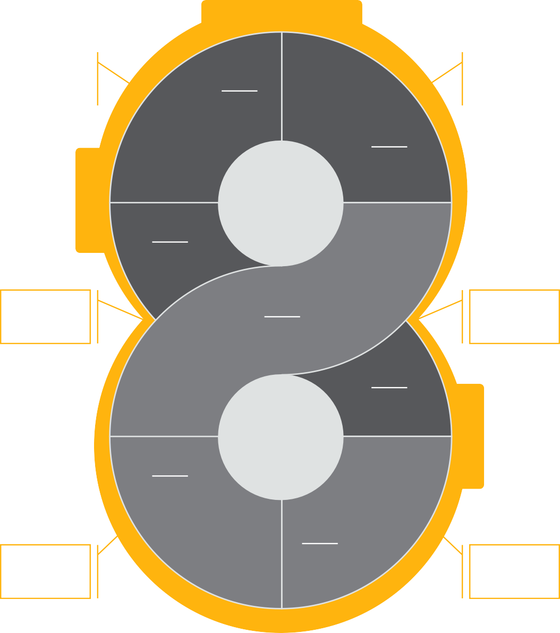
Objective: Continuous testing
Continuous testing means doing testing without interruption
Originally, the term continuous testing referred to the ability of executing automated tests as part of the software delivery pipeline to continuously obtain quality-related information about the software
Nowadays, continuous testing refers to the diffusion of software testing from a distinct as well as siloed pre-release phase to an ongoing, continuous activity
Continuous Testing
We test here!
Design
We test here too!
2
Plan
1
Shift Left
Dev
Develop
3
We also test here!
Monitor
7
Yes! Here, we test!
Build
4
Ops
Shift Right
Operate
6
Deploy
5
And here we test!
Do we test here? Yes.
Notes:
So, the term continuous testing suggests that testing shouldn't be seen as an isolated, disconnected island in the software delivery pipeline anymore. It rather suggests that software testing should be performed at any time, everywhere, in any form (e.g., automated, manual, exploratory testing).
Read Slide
This is a continuous process, so continuous enhancements and continuous bug fixes are very common. Continuous development relies on Continuous Quality. Thus, the need of adopting Automation Testing is high, to test early, often & quicker and at scale, to achieve faster time to market.

Slide 21
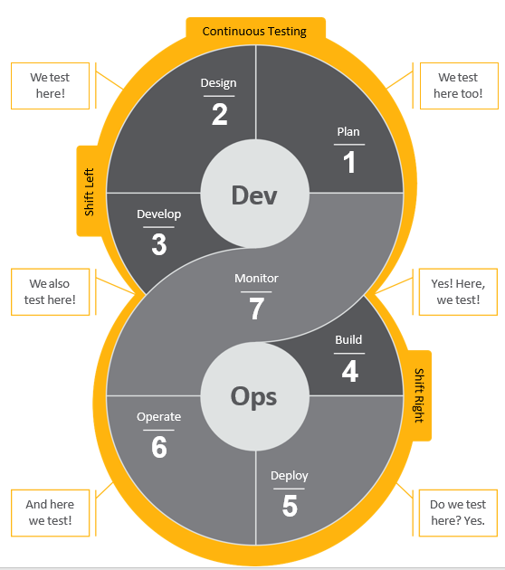
Continuous testing (shift-left, shift-right)
Shift-left is the practice of moving testing, quality, and performance evaluation early in the software development process, thus the process of shifting to the “left” side of the DevOps lifecycle. This concept has become increasingly important as teams face pressure to deliver software faster and more frequently with higher quality.
Shift-left speeds up development efficiency and reduces costs by detecting and addressing software defects earlier in the development cycle before they get to production.
Shift–right is the practice of performing testing, quality, and performance evaluation in production under real-world conditions. Shift-right methods ensure that applications running in production can withstand real user load while ensuring the same high levels of quality.
With shift right, DevOps teams test a built application to ensure performance, resilience, and software reliability. The goal is to detect and remediate issues that would be difficult to anticipate in development environments.
Notes:
If you look, continuous testing adapts both shift-left and shift-right.
Read Slide

Slide 22

So what do we need?
Unified Test Platform
(Create, Execute, and maintain)
Support
shift-left
Support
shift-right
Notes:
Ok, So I think you got the problem statetment, but
How we can empower our test teams with all the tools they need to manage, automate, distribute, and execute their work?
How we can build resilient automation?
How we can Proactively manage quality to prevent production disruptions?
How we can Continuously test to uncover and fix underlying issues?

Slide 23



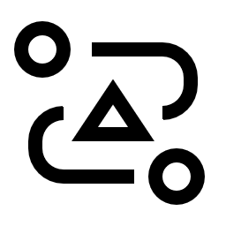




Meet Test Suite…
The solution
Test manager app
Cloud
UiPath
Studio
ServiceNow
TM 2.0
SAP solution manager
Production-grade automation
UiPath
Orchestrator
Automate any UI or API technology
Test Manager Hub
Azure DevOps
Share and reuse automations
Connectors
CI/CD integration
Seamlessly integrates with your toolchain
Atlassian Jira
X-ray
UiPath
Robots
Your tool
SDK
On-premise
23
Notes:
Ui Path Test Suite combines the world's leading RPA technology with best-of-breed testing capabilities to sustainably accelerate scaling through proactive testing, cross-enterprise collaboration, and a consistent approach to creating and deploying automation.
With UiPath you can revolutionize automated testing for your software, automation, and QA teams with Test Suite: the resilient testing product portfolio powered by the UiPath Automation Platform.
Leverage production-grade, low-code automation, and AI power tools to automate testing for any technology while still managing testing your way.
The UiPath Test Suite aims to accelerate digital transformation by unlocking the potential of continuous testing.

Slide 24










UiPath Test Suite Product Architecture
◢ Connectors
UiPath Automation Hub*
Test Manager Hub
◢ Web Service
Automate
Postman, SauceLabs,
Appium &
Future Integrations
Atlassian Jira
SAP Solution Manager
Azure DevOps
Jenkins AzureDevOps Future DevOps Integrations
REST API
ServiceNow
Xray
Your Tools
Test Robots
SDK
Execute
◢ Web Application
Manage
Requirements Mgmt
Analytics & Reporting
Manual Testing
Exploratory Testing
UiPath Task Capture
Notes:
With UiPath Test Suite, you can Elevate your automated enterprise testing experience with the power of the UiPath Automation Platform
Create a simpler, smoother, and more productive testing experience by empowering your test teams with all the tools they need to manage, automate, distribute, and execute their work: Test Manager, Studio, Orchestrator, and Test Robots.
Proactively manage quality to prevent production disruptions with UiPath Test Manager
Kickstart the testing process by planning and monitoring tests for any of your automation, applications, or environments. With full requirements traceability and visual logging, Test Manager enables you to rapidly triage any defects.
It also seamlessly connects to your application lifecycle management (ALM) toolchain and integrates with tools like ServiceNow, SAP Solution Manager, and Azure DevOps.
Build resilient automation faster with UiPath Studio
Whether you’re testing RPA workflows, web apps, SAP®, Citrix, or mobile, Studio has you covered with its low-code interface, synthetic test data generation, and hundreds of prebuilt activities.
Continuously test to uncover and fix underlying issues with UiPath Orchestrator
With Orchestrator, UiPath automation control center, you can easily organize, schedule, store dynamic test data, and analyze detailed results for test execution. It's Veracode certified and integrates into your DevOps toolchain.
Deploy test robots to execute tests on-demand, continuously, and at scale
By leveraging UiPath test robots, you can build a team of dedicated robots to run tests, perform common tasks, and report back anytime you want them to.

Slide 25
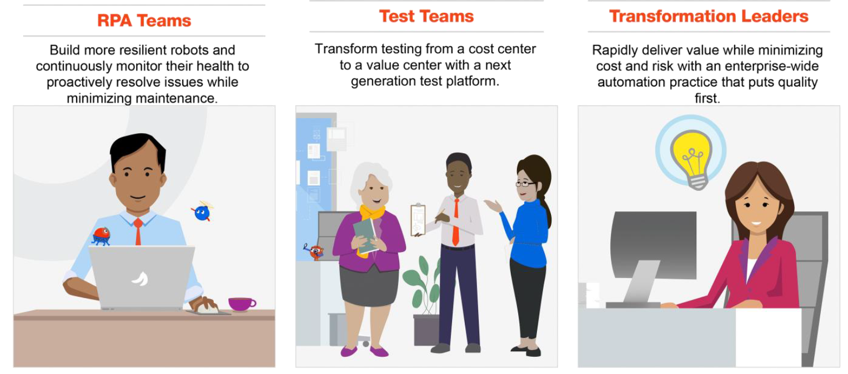
Benefits those who create and depends on automations
RPA developers: build more, test better, fix never*
*Okay, hardly ever
Create test automation faster with a low-code interface and hundreds of pre-built components
Automatically create data to test your RPA workflows
Share and reuse automation and tests cases from a centralized library
Leverage dashboards to monitor the quality of robots, applications, and the environment
Quickly receive test results so you can fix issues before going live
Notes:
Focus on building resilient automation, not maintaining:

Slide 26
Benefits those who create and depends on automations
Test teams: power up with AI-enabled automation and new RPA innovations
Automate testing of virtually any software application—old or new, and on any device
Synthetically generate test data and enforce test automation standards with rules and definitions
Use digital tools and assistants to aid in eliminating mundane tasks
Manage testing your way with migration options
Create a library of reusable, shareable automation components and objects
Notes:
Proactively ensure testing across your entire enterprise technology ecosystem:

Slide 27
Benefits those who create and depends on automations
Transformation leaders: create a world-class automation practice
Centralize governance by using a common automation platform and approach
Ensure every automation you launch is resilient, compliant, and high performing
Build automation momentum by sharing automation across your cross-functional business
Scale faster by sharing skills, experience, and automation resources across your organization
Proactively manage quality to prevent production disruptions
Notes:
Manage an enterprise-wide automation program that puts quality first:

Slide 28
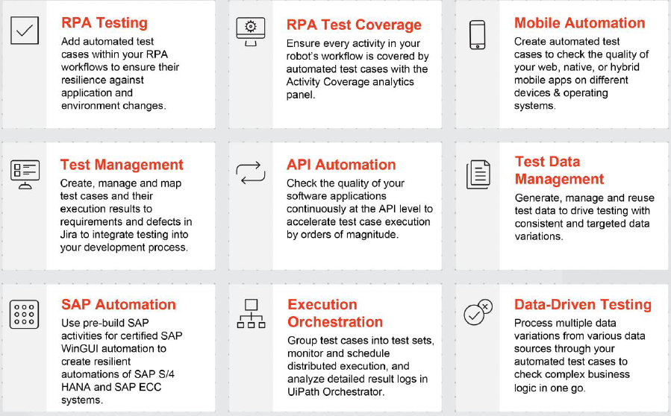

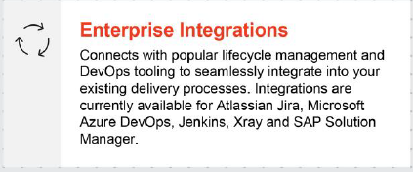
Assembling the industry’s top capabilities

Slide 29
Test Suite and the UiPath Platform

Slide 30








The UiPath Platform supports Enterprise Automation
Devops Automation ops
Centrally control and monitor your automation
Development
IT
Business
Test automation
IT automation
Process automation
RPA testing
RPA testing
Share and reuse automation, infrastructure and skills

Slide 31







Test Suite is fully integrated into the UiPath Platform
In a fully automated enterprise, when robots keep doing their job, the entire organization benefits – more resilient automations minimize maintenance required and instills confidence in the business, allowing scaling to accelerate.
Identify automatable candidates and
define requirements
Rapidly build and test resilient automations
Process Mining
Task Capture
Automation Hub
Studio
AI Computer Vision
Marketplace & Integrations
Robots
RUN
Reliable robots that keep working
minimize maintenance
Continuously monitor the health of your robots and applications
Unattended Robots
Test Robots
Orchestrator
Test Manager
AutomationOps

Slide 32






Why Should You Care?
Share and reuse automation components and objects
Perfect fit into your existing DevOps toolchain
Automate virtually any UI, API or packaged application
Leading RPA and AI innovation
Production-grade Automation and Orchestration
Vibrant Community & Marketplace
Notes:
(Why Test Suite is different)
Share and reuse – Chipotle achieves 70% reuse between testing and RPA
Automate any technology – Test Suite is a one-stop shop for all your testing needs, many customers have replaced their bucket of tools with Test Suite
Production-grade – UiPath is the only testing vendor who comes from production – Vericode certified and approved by the Defense Information Systems Agency
UiPath has built Test Suite to integrate seamlessly into your DevOps toolchain
UiPath is the only vendor that is surrounding every tester with RPA and AI power tools – chatbots, test data generator, auto-generation of test cases, process mining, task mining and change impact mining
UiPath has a community of over 1.5M users and our marketplace has hundreds of pre-built automations and connectors to accelerate automation of test cases

Slide 33

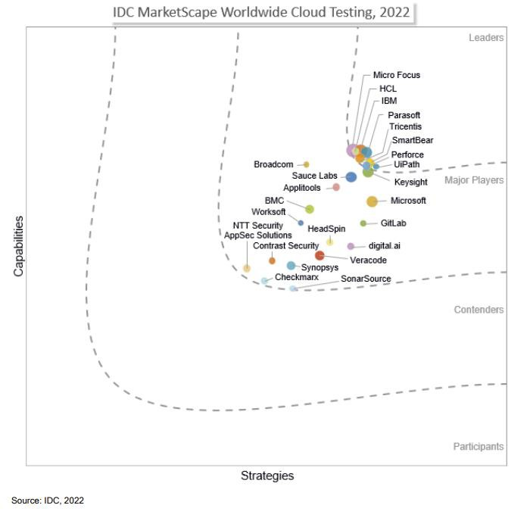

UiPath named a leader in IDC MarketScape for Worldwide Cloud Testing Vendor Assessment
Debuted as a leader
Earned top score in strategy
Notes:
Within the report, the IDC MarketScape recognizes UiPath for capitalizing on its Robotic Process Automation (RPA) technology and dominant position in the enterprise automation market to help enable timely, needed coordination and synergy for the testing of automations.

Slide 34










You’re in good company…
Join our growing Test Suite customer community

Slide 35


Q & A

Slide 36
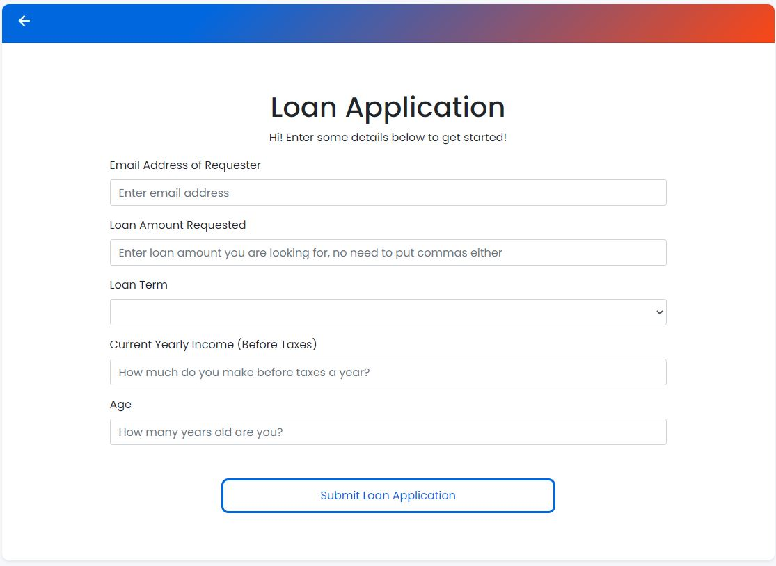
Shift-left (Computer vision example)

Slide 37



Scale with confidence with Test Suite
Before Test Suite
After Test Suite
Build
Build automations quickly, from the simple to the advanced
Workflow is tested with few verifications and limited data variations. |  | Both the workflow and activities are unit tested thoroughly in an automated fashion.
Workflow is published to production with no ability to monitor automation health with continuous testing. |  | Workflow is published along with all test cases, allowing ongoing monitoring of automation health with continuous testing.
Issues are fixed reactively as they are found, leading to unplanned maintenance and business disruption |  | Issues are found in a staging or test environment, allowing for proactive maintenance.
Manage
Manage, deploy, and optimize automation at enterprise scale
Run
Run automations through robots that work with your applications and data
Elevated risk of production
disruptions
Higher rate of maintenance
Diminishing returns
Slower scaling
Maximize automation uptime
Lower rate of maintenance
Rapid return on investment
Accelerated scaling
41

Slide 38









03
The future of testing is
digital!
The Digital Tester
Deep domain knowledge
01
Manual tester
Equipped with tools supporting all areas of daily work
Curious and focused on detail
02
Test automation engineer
Eliminating repetitive manual tasks via robot assistants
Leveraging smart technology
to make informed decisions
38
13

Slide 39




For QA/Test Teams
90%
Automation rate
RPA and AI Innovation
Value contributor
Empowering the
Digital Tester

Slide 40


For RPA Developers
Quality Mindset & Skills
QA
Management
RPA
Testing Tools
Enabling the
Digital Tester

Slide 41
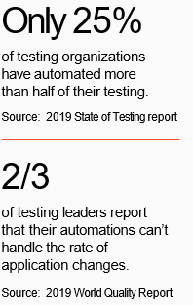

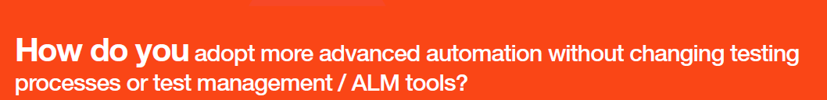
The Challenge
. . . with ﬁnite stafﬁng and testing resources
Test faster, test more, test often . . .
How do you adopt more advanced automation without changing testing processes or test management / ALM tools?

